Slide 1
Examples of how to achieve consistency in NoSQL stores

Slide 2
We will study three contrasting NoSQL stores
BigTable / HBase
DynamoDB
Spanner

Slide 3
BigTable
BigTable was one of the first NoSQL stores ever created.
Fay Chang, Jeffrey Dean, et al., Bigtable: A distributed storage system for structured data, OSDI, 2006
In some ways it started the trend for NoSQL stores.
BigTable was developed by Google to handle the scale problem
Lots of data
Millions of machines
Different project/applications
Hundreds of millions of users
At that time no commercial system was big enough

Slide 4
HBase
HBase is an open source clone of BigTable which is designed to work in Hadoop.
We will focus on HBase since it is open source and it is integrated with Hadoop.
HBase is a distributed column-oriented data store built on top of HDFS
Data is logically organized into tables, rows and columns

Slide 5
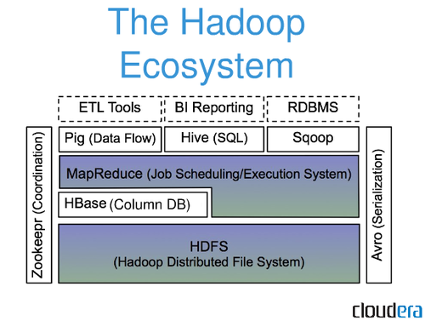
HBase: Part of Hadoop’s Ecosystem
HBase is built on top of HDFS
HBase files are internally stored in HDFS
5

Slide 6
HBase vs. HDFS
Both are distributed systems that scale to hundreds or thousands of nodes
HDFS is good for batch processing (scans over big files)
Not good for record lookup
Not good for incremental addition of small batches
Not good for updates

Slide 7
HBase vs. HDFS
HBase is designed to efficiently address the following points
Fast record lookup
Support for record-level insertion
Support for updates (not in place)
HBase updates are done by creating new versions of values

Slide 8
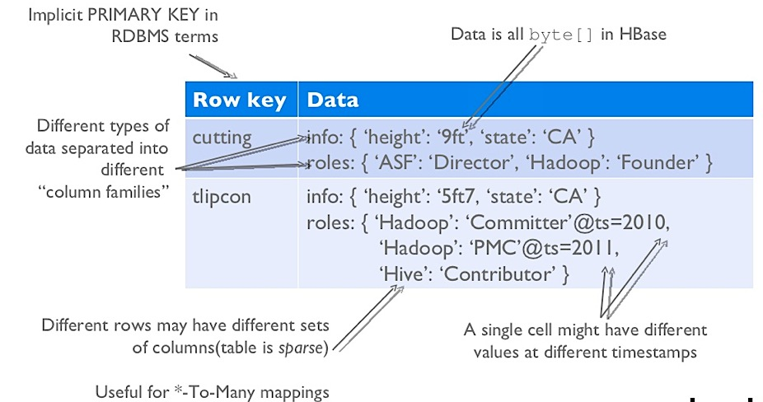
Hbase Has No Schema
Each row can have a different number of columns.
A single cell can have different values at different timestamps.

Slide 9
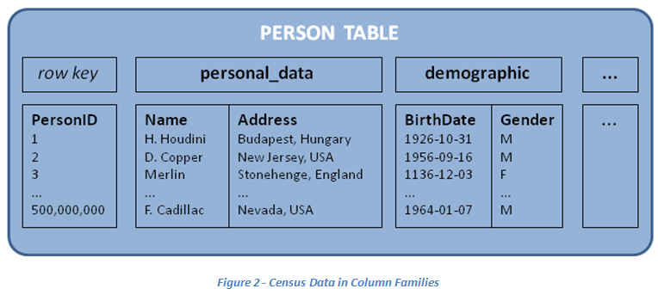
HBase Data Model: Keys and Column Families
Each record is divided into Column Families
Each row has a Key
Each column family consists of one or more Columns

Slide 10
Column family named “Contents”
Column family named “anchor”
Key
Byte array
Serves as the primary key for the table
Indexed for fast lookup
Column Family
Has a name (string)
Contains one or more related columns
Column
Belongs to one column family
Included inside the row
familyName:columnName
Column named “apache.com”

Slide 11
Version number for each row
Version Number
Unique within each key
By default→ System’s timestamp
Data type is Long
Value (Cell)
Byte array
value

Slide 12
Column Families
Column families are stored separately on disk: access one without wasting IO on the other
Different sets of columns may have different properties and access patterns
Configurable by column family:
Compression (none, gzip, LZO)
One compression method might work better than another method for a particular column family
Version retention policies
Cache priority

Slide 13
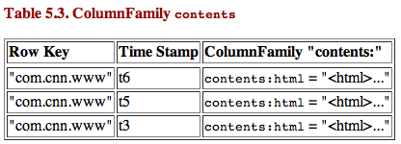
HBase Regions
Each HTable (column family) is partitioned horizontally into regions
Regions are counterpart to HDFS blocks
Each region stores a subset of the rows of the table.
Each will be one region

Slide 14
HBase Architecture
The HBaseMaster
One master
The HRegionServer
Many region servers
The HBase client

Slide 15
HBase Components
HRegion
A subset of a table’s rows, like horizontal range partitioning
Automatically done
HRegionServer (slaves)
Manages data regions
Serves data reads and writes (using a log) requests of clients
Send heartbeat to master
Master
Responsible for monitoring region servers
Load balancing for regions
Redirect client to correct region servers.
Detects failures
Single point of failure

Slide 16
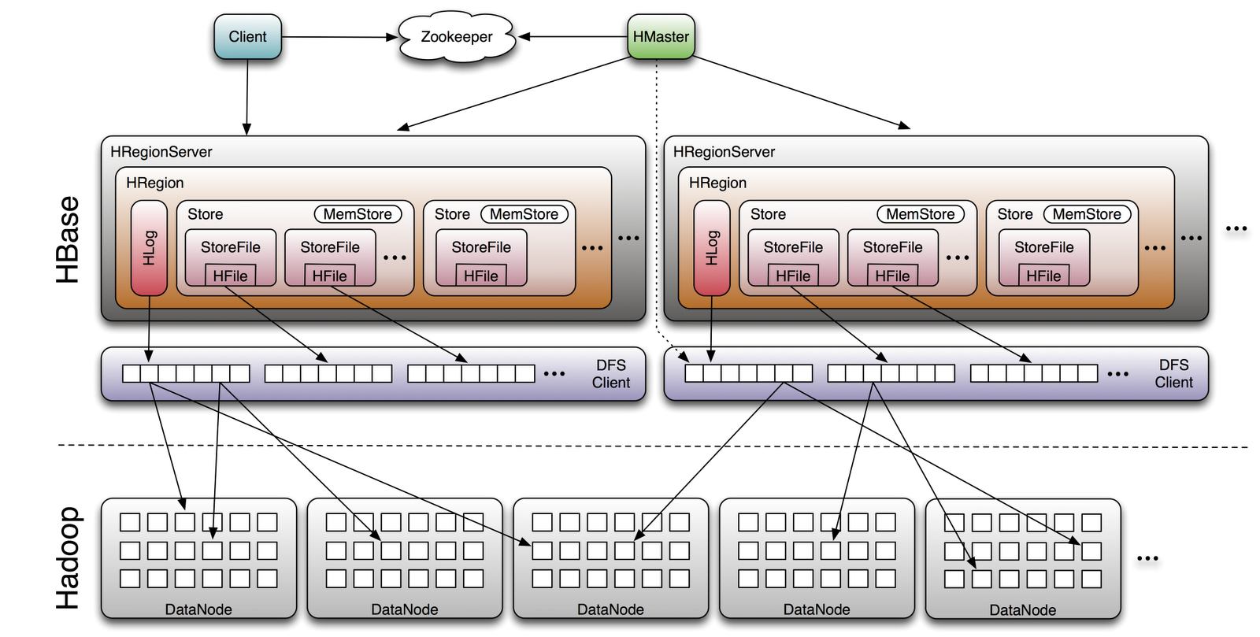
HBase Architecture

Slide 17
HBase: Joins
HBase does not support joins
If you want to do joins then you need to do it in the application layer.

Slide 18
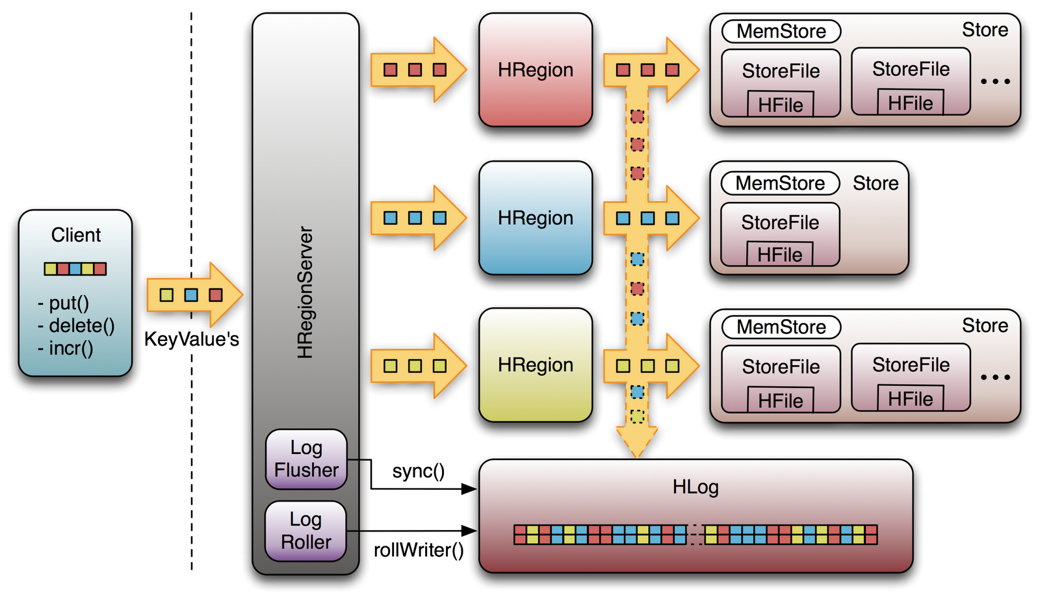
HBase Updates

Slide 19
HBase Updates
Updates are logged, then stored in the in-memory MemStore.
Later during a read request, the store file will be loaded and the updates in the MemStore are applied to return the latest version.

Slide 20
HBase: Merge Updates
When the MemStore becomes too full it is saved into HDFS as a store file.
Stores files are later merged together to reduce the number of store files.
Using this approach we never do inplace updates on the store file, since we can not perform inplace updates in HDFS.

Slide 21
DynamoDB
The NoSQL store offered by Amazon Web Services
Giuseppe DeCandia, Deniz Hastorun, et. al. Dynamo: Amazon’s Highly Available Key-value store, SOSP’ 07.
Offered by AWS as a web service
Low Latency
SSD-based storage nodes
Massive and seamless scalability
No table size or throughput limits
Live repartitioning for changes to storage and throughput
Predicable performance
Provisioned throughput model
“ProvisionedThroughput”:{“ReadsPerSecond”:500. “WritesPerSecond”:100}
Durable and available
Zero administration

Slide 22
Durability and Availability
Consistency
Writes are always consistent (atomic insertions at the record level)
Reads are eventually consistent (default), or can be configured to be completely consistent (lowers write throughput).
Durability
All writes occur to disk, not memory
A write is only acknowledged(committed) once it exists in at least two physical data centers
Availability
Regional service
Spans multiple availability zones
All data is continuously replicated to multiple availability zones.

Slide 23
DynamoDB Joins
Complex Queries
Sophisticated, SQL-based querying of DynamoDB tables: GROUP BY, JOIN, HAVING, secondary indices, etc.
Complex Joins
Ability to join live tables in DynamoDB with archived tables in S3.

Slide 24
DynamoDB Data Model
Three model concepts: tables, items and attributes
A DynamoDB database is a collection of tables.
Each table stores a collection of items.
The items consists of a set of attributes and associated values.
Each item can have a different number of attributes.
This means DynamoDB does not impose a schema on the data
One attribute must be the key attribute.
DynamoDB can lookup a particular item in a table efficiently by using a hash index on the key.

Slide 25
DynamoDB Data Model Example
Below are two example items stored in the same table.
Notice the two above example items stored in dynamoDB are very different in terms of what attributes they contain. This is allowed in dynamoDB since it is schema less.
However, note all the items must have the same key attribute.
This is used to lookup the items.
{
Id = 101
ProductName = "Book 101 Title"
ISBN = "111-1111111111"
Authors = [ "Author 1", "Author 2" ]
Price = -2
Dimensions = "8.5 x 11.0 x 0.5"
PageCount = 500
InPublication = 1
ProductCategory = "Book"
}
{
Id = 201
ProductName = "18-Bicycle 201"
Description = "201 description"
BicycleType = "Road"
Brand = "Brand-Company A"
Price = 100
Gender = "M"
Color = [ "Red", "Black" ]
ProductCategory = "Bike"
}

Slide 26
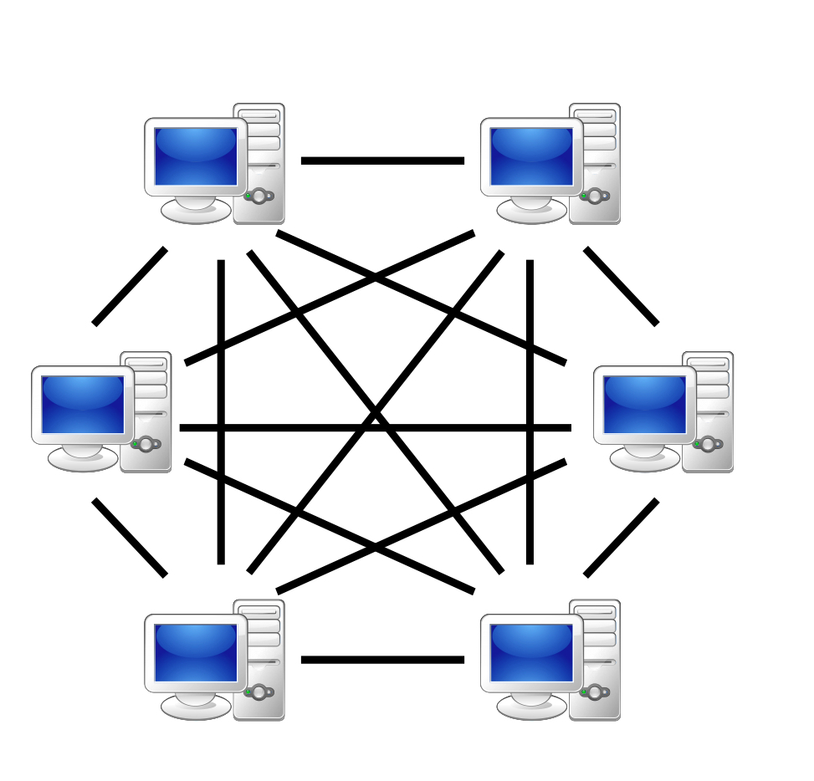
Peer-to-peer architecture
DynamoDB has a peer-to-peer architecture.
This means there is no master node.
All DynamoDB nodes are treated equally.
Client can connect to any node to get data and put data.

Slide 27
Peer-to-peer architecture
The main benefit of peer-to-peer architecture is that there is no single point of failure.
Can scale higher since there is no master which can often become a source of bottleneck.
However having a peer-to-peer architecture makes it hard to keep track of where replicas reside.
DynamoDB uses a smart method called consistent hashing to address this challenge

Slide 28
Spanner
Google finally is admitting that there are many places it is just nicer to have a database rather than NoSQL.
Spanner database at the planet scale.
James C. Corbett, Jeffrey Dean, et al., Spanner: Google’s Globally-Distributed Database, OSDI 2012, best paper.
In NoSQL system if people want strong consistency they need to write it in the application layer.
Very hard to do and get it right!
Transactions are much more user friendly than the weak consistency guarantees of typical NoSQL stores.
Quote from the paper:
“We believe it is better to have application programmer deal with performance problems due to overuse of transactions as bottlenecks arise, rather than always coding around the lack of transactions.”

Slide 29
What is Spanner?
Distributed multiversion database
General-purpose transactions (ACID)
SQL query language
Schematized tables
Running in production
Storage for Google’s ad data
Google system which is not open source.
Currently no popular open source implementation of spanner yet.

Slide 30
Example: Social Network at planet scale!
Sao Paulo
Santiago
Buenos Aires
x1000
San Francisco
Seattle
Arizona
Brazil
User posts
Friend lists
User posts
Friend lists
User posts
Friend lists
User posts
Friend lists
User posts
Friend lists
x1000
Moscow
Berlin
Krakow
US
London
Paris
Berlin
Madrid
Lisbon
x1000
x1000
Russia
Spain

Slide 31
How does spanner do it?
This is quite complex, too much detail for this course.
If you are interested please read the paper and watch the presentation from here:
https://www.usenix.org/conference/osdi12/technical-sessions/presentation/corbett

